Slide 1
AUTOMATED GAS EXHAUSTER AND TEMPERATURE SENSOR
GROUP 8
Mayank Garg (20CE10035)
Aryan (20CE10015)
Jay Ramesh Anantwar (20AE10017)
Binay Bhattacharya (20CH10012)

Slide 2
CONTENT
The problem we are solving
Our solution
Scientific mechanism and theories involved in the device
Main apparatus used
Scope of the device
Circuit diagram
Link for TinkerCAD circuit
Gas sensor structure
Temperature sensor structure
Limitations
Assumptions
Contribution of the members
References

Slide 3
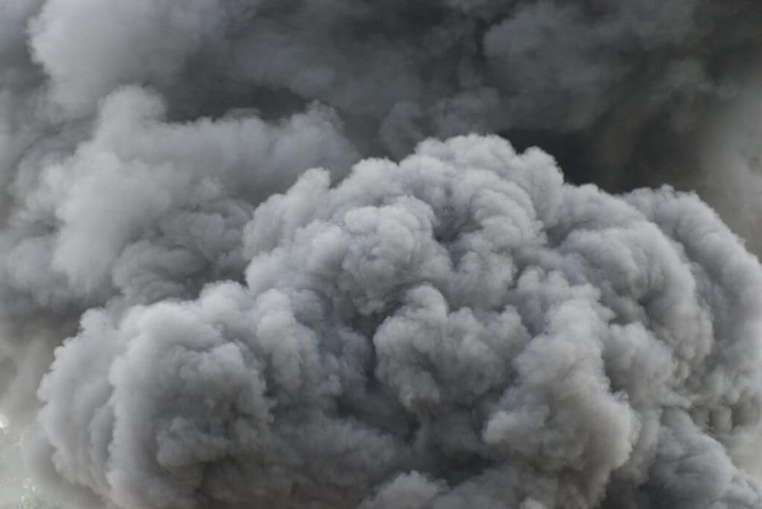

THE PROBLEM…
“ IN INDIA, 2 PEOPLE DIE DUE TO GAS POISONING EVERY DAY. ”
If there is high amount of toxic gas in a room, we need a mechanism that would
Warn the people
Remove the toxic gas from the room
Be automated

Slide 4
THE SOLUTION…
An Automated Gas Exhauster
Gives warning when there is potential toxic gas
Ejects out the toxic gas/smoke automatically
Also works as temperature regulator

Slide 5
MECHANISM OF DEVICE
There are two major functions of the device –
Toxic gas removal
Temperature regulation

Slide 6
Prescribed levels of gases at home
Gases | Concentration(for max 1 HR at once in a year)
CO | 9ppm
SO2 | 75ppb
NOx | 100ppb
CO2 | 250-350ppm

Slide 7
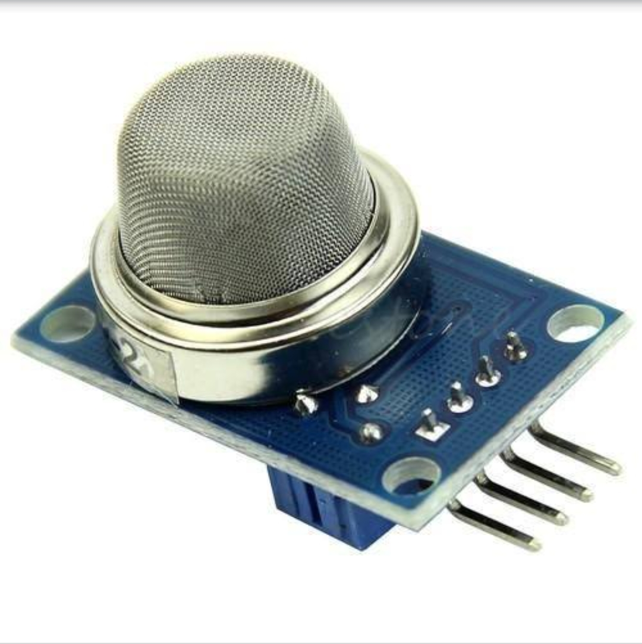
GAS SENSOR
Most commonly used sensor – Metal oxide type
When the sensor is placed in the toxic or combustible gases environment, this reducing gas (orange color) reacts with the adsorbed oxygen particles and breaks the chemical bond between oxygen and free electrons thus releasing the free electrons. As the free electrons are back to its initial position they can now conduct current, this conduction will be proportional the amount of free electrons available in SnO2

Slide 8
The voltage that the sensor outputs changes accordingly to the smoke/gas level that exists in the atmosphere. The sensor outputs a voltage that is proportional to the concentration of smoke/gas.

Slide 9
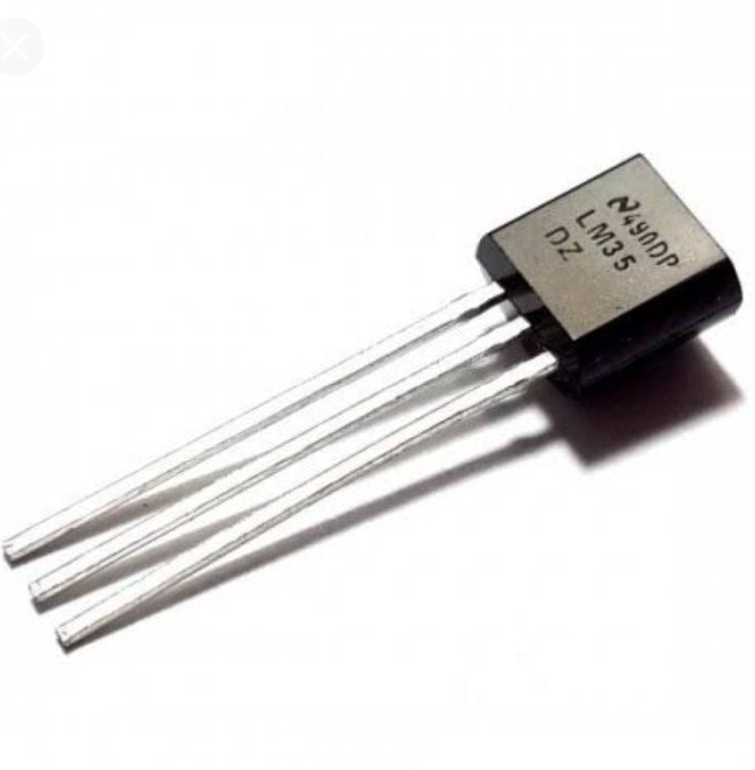
TEMPERATURE SENSOR
Measures temperature through electric signals.
Most common type - thermocouple

Slide 10
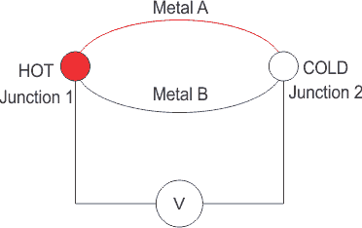
SEEBECK EFFECT
Thermocouple has two metal wires. When there is temperature difference between them, a potential difference is created. This is called Seebeck Effect.

Slide 11
GREATER SCOPE OF THE DEVICE
adding a servo motor and connecting it to the ventilator for better regulation of air in the room
humidity sensor can also be added

Slide 12
APPLICATIONS…
For home safety
In hospitals, for the welfare of patients and medical staff

Slide 13
DIAGRAM

Slide 14


Slide 15
LINK FOR THE TINKERCAD CIRCUIT
https://www.tinkercad.com/things/2NqYQiDz005-copy-of-automatic-gas-exhausterand-siren-as-per-the-level-of/editel?sharecode=WWVhhkUWf0G5o0Z7wS7xBDII9cW3AysquUbjguW6Bzk

Slide 16
GAS SENSOR STRUCTURE
MOTOR STARTS WHEN GAS CONC. > 100 PPM
PIEZO ALARM RINGS WHEN GAS CONC. > 250 PPM
THERE ARE MANY TYPES OF GAS SENSORS FOR IDENTIFYING DIFFERENT GASES. WE CAN CONNECT MULTIPLE SENSORS WITH DIFFERENT LIMITS TO CHECK DIFFERENT GASES.
CO
NOx
SO2

Slide 17

TEMPERATURE SENSOR
MOTOR STARTS WHEN TEMPERATURE > 40 DEGREE CELSIUS
MOTOR CONSTANTLY RUNS FOR 5 SECONDS, AFTER WHICH, THE TEMPERATURE IS CHECKED AGAIN.
IN REAL LIFE, THE TIME DURATION WOULD BE LONGER THAN 5 SECONDS (AROUND 5 MINUTES) BUT FOR CONVENIENCE, WE TOOK A SMALL TIME UNIT.

Slide 18
LIMITATIONS
In real life, a gas sensor can’t detect a single gas uniquely; rather, it senses multiple gases of the same category.
In our temperature “moving average” model, we are finding average of temperature readings. So, if any reading becomes abruptly (largely) wrong, it will cause an error in the device.
TinkerCAD doesn’t provide facility to use AC motor with Arduino.

Slide 19
ASSUMPTIONS
We assume that in houses, only one gas of a PARTICULAR CATEGORY is vulnerable.
In the temperature “moving average” model, we assume that the Temperature values in data set are realistically correct.
We also assume that our device will work efficiently without any technical glitch.

Slide 20
CONTRIBUTIONS
Binay : 3D model creation, PPT representation and its
designing
Aryan : Temperature system Coding, critical commentator and PPT coordinator
Jay : designing, critical commentator and PPT coordinator
Mayank : Gas system coding, critical commentator and PPT coordinator

Slide 21
REFERENCES
Articles on temperature sensor and science behind it
Articles on gas sensor and its working mechanism
Videos on setting up LCD screen in TinkerCAD and code

Slide 22
THANK YOU

